Slide 1
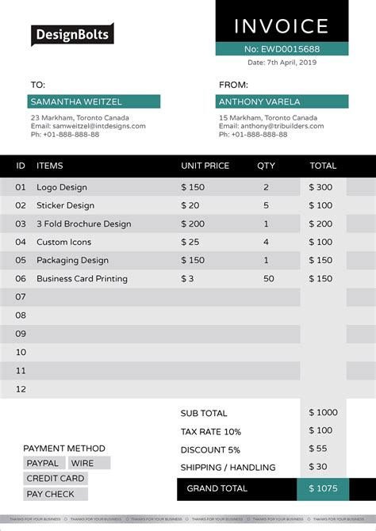
My Solution to the Problem
The problem statement stated that we are supposed to find a solution to extracting the Total Amount from any Company Invoice in the pdf file format.
The total amount of any company invoice is a float value which is represented in the decimal format so it can be differentiated from the date and invoice number easily.
Also the total amount is the greatest float value of all the values in the invoice.

Slide 2
Firstly I used the borb library a library used for creating and manipulating PDF files in python. I used it to extract text from the PDF file.
The text from the PDF is extracted and stored it into a .txt file.
Using the regular expression I am able to get the float values from(separate from string data) the txt file and compile it into a list.
The max function is then used to get the maximum floating value from this list which is the total amount of the invoice.

